Slide 1
Uneven Bars Final Presentation
Jiabin Liu
Jordan Zeeb
Mackenzie Gray
Anuj Karnik
Sarah Ziselman
Joe Fonstein
Notes:
Hi everyone, my name is Joe and with me here today we have Jiabin, Jordan, Makenzie, AJ, and Sarah. We’ve been giving this project our all for the past 6 months now, and we’re all very proud to be here today to show off what we’ve managed to acomplish.

Slide 2
The Uneven Bars
Consists of gymnasts performing a skills routine between two offset bars
Emphasizes the grace and agility of athlete as opposed to brute strength and stamina
Many of our design decisions were directed by studying actual gymnasts
Notes:
To start off, we want to give a brief background of the sport. In gymnastics competition, the

Slide 3
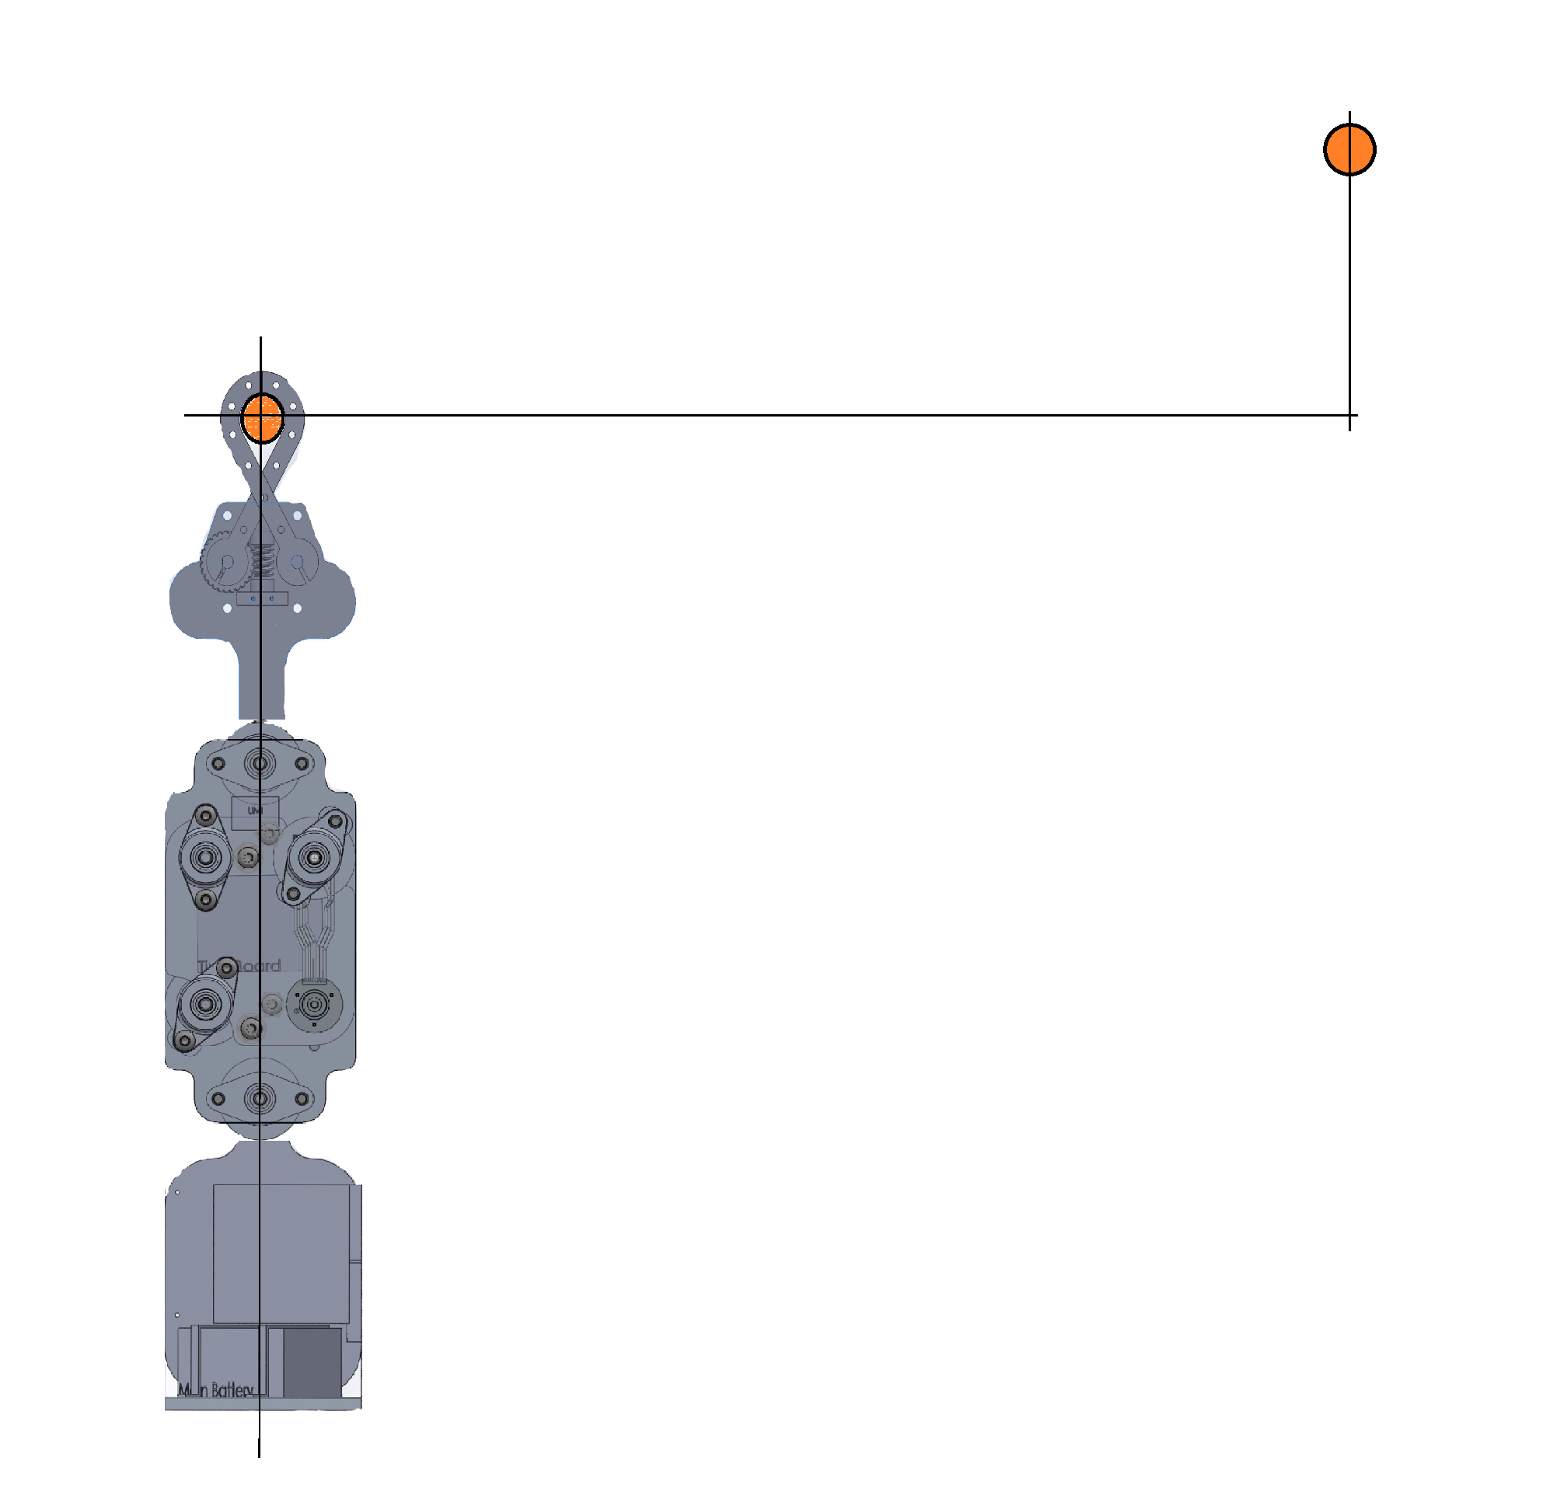
The setup
The actual bars set 6ft apart horizontally and 2.5 feet apart vertically.
Our bot is a ~1:4 scaled down model
~4.7 in
~12 in
~19 in

Slide 4
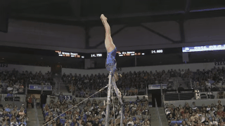
The Tricks: The Giant Swing

Slide 5
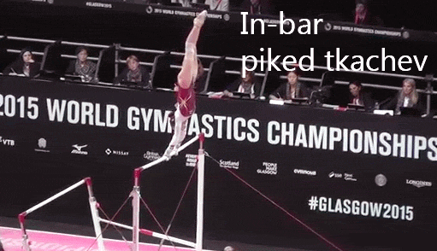
The Tricks: The Tkatchev
Notes:
Are we having a trick each on a slide, or all together.?
Each has its own slide
Though i dont really care either way if you have an opinion

Slide 6
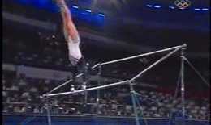
The Tricks: The Clear Hip Hetch

Slide 7
Robot Design

Slide 8
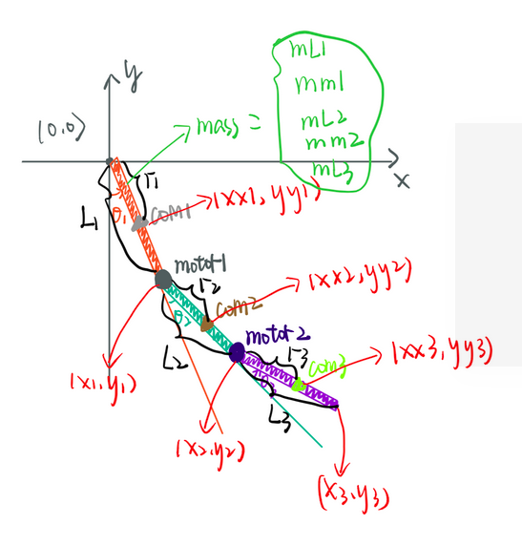
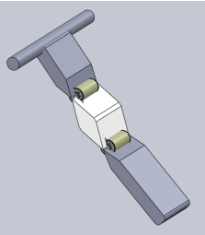
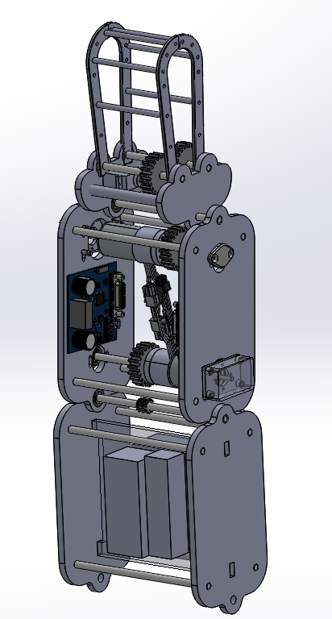
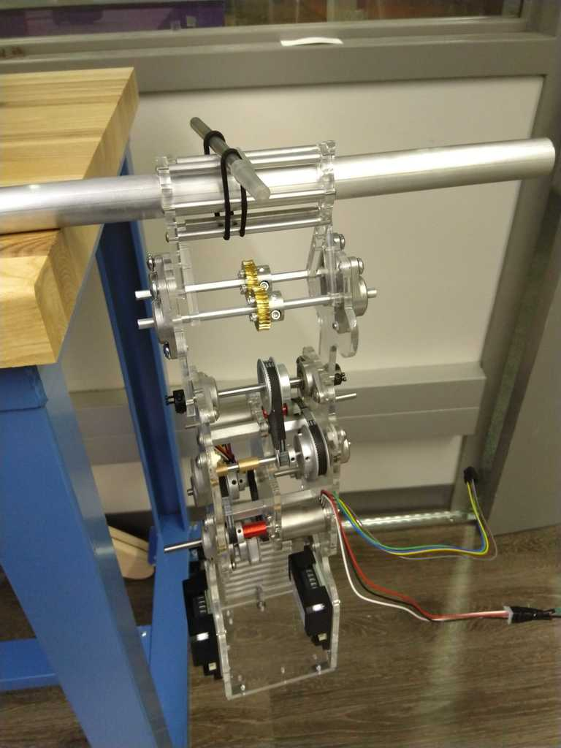
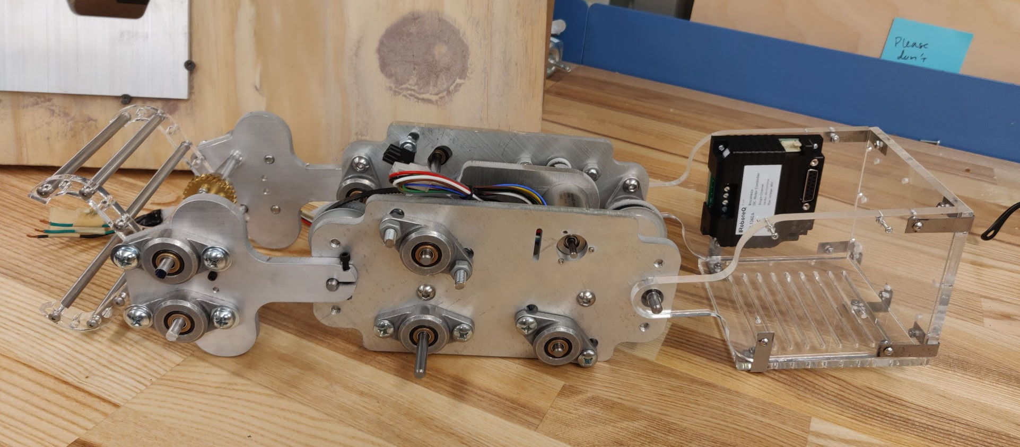
Design Evolution

Slide 9
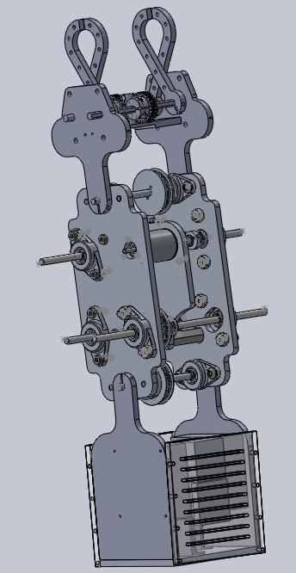
Top Link
“Hands” of the robot
Actuates Gripper to smoothly catch bars
Middle Link
“Muscles” of the robot
Contains primary motors that drive rotation between links
Bottom Link
“Brains” of the robot
Holds electronics and battery

Slide 10

The Hardware
Aluminum 6061 body.
2 x 45W Maxon motors coupled to a 1:3 reduction belt - pulley system.
Gripper driven by worm and worm gear.
Roboteq amplifiers.
2 x Absolute encoders & 2 x Incremental encoders
Single Bosch IMU on the top link.
Made a full size acrylic prototype to find issues with the assembly and cable routing.

Slide 11
State of Robot going into Spring Quarter

Slide 12
Simulation

Slide 13
Need for simulation...
Validates selected motor and control strategy
Helps visualize the constraints, impacts and controls that are present.
Dead reckoning approach using trial and error
Help us get a set of initial states for releasing and catching
Assumptions/Adjustments..
Mass and inertia of links simplified from actual CAD model
Gripper currently ineffective
Instead we use (x,y) location of the robot to determine if it catches the bar successfully
Based on equations of motion of a triple pendulum.
Notes:
Crashes will happen. But hopefully they will be fewer in number.

Slide 14
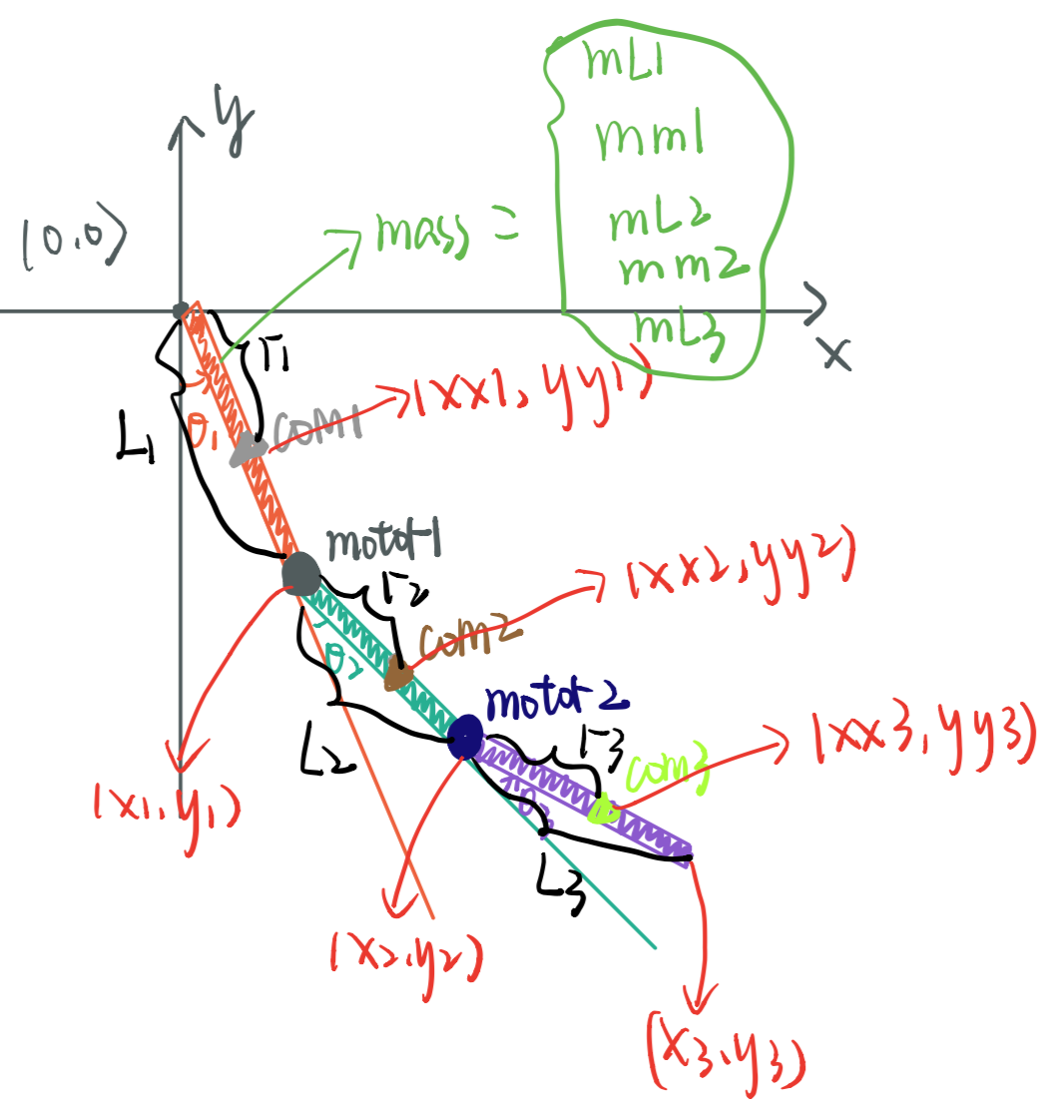
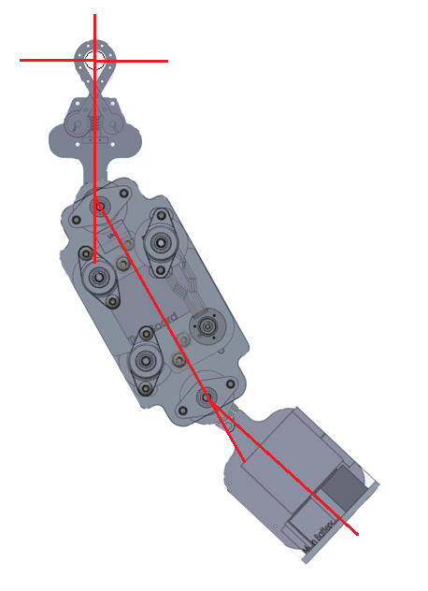
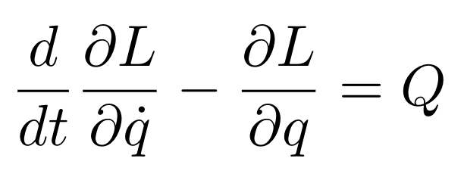
Simulation: Fundamental Equations
Generalized Coordinates: x, y, theta_1, theta_2, theta_3
Forward Kinematics Equations:
x-location of top link CoM
y-location of top link CoM
Etc.
Use Energy to Solve for Lagrangian (KE-PE)
Euler-Lagrange Equations

Slide 15
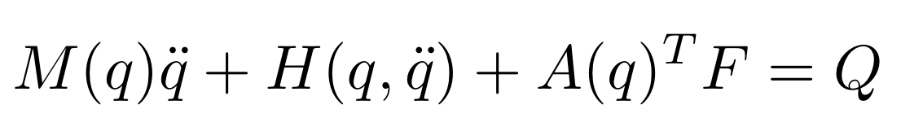
Simulation: Fundamental Equations
Solve for Mass Matrix, H Matrix (Coriolis and Gravity), Q vector
Q = [0; 0; 0; tau_shoulders; tau_hips]
Motors are only applying torque at shoulders and hips
tau_shoulders and tau_hips will be adjusted depending on which controls are activated
Constraint Equations:
c_x = x
c_y = y
A Matrix (derivative of constraints) and Hessians
Everything in this section of the code is solved symbolically
Makes use of auto-generated functions, which are called in other areas of the code

Slide 16
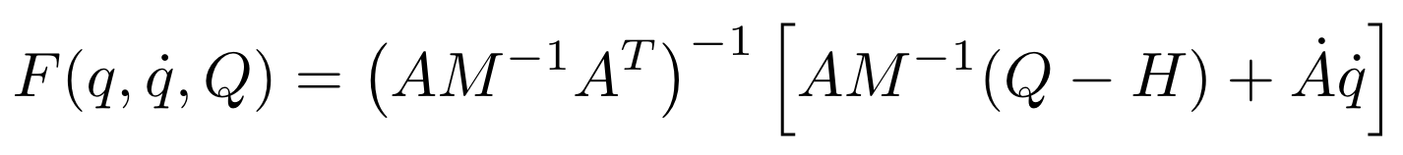
Simulation: Main
Create phases:
pumping, flight, etc.
Each phase has different constraint forces, impacts, controls
Events:
Measuring values (i.e. potential energy, location, etc.) allows us to detect events and change between phases
Constraint Forces
Fortunately, our constraint equations were simple and could be used for both bars
Numerical Integration
Use ODE45 to solve for:
tsim (1xN matrix)
xsim (10xN matrix)
N is number of time steps

Slide 17
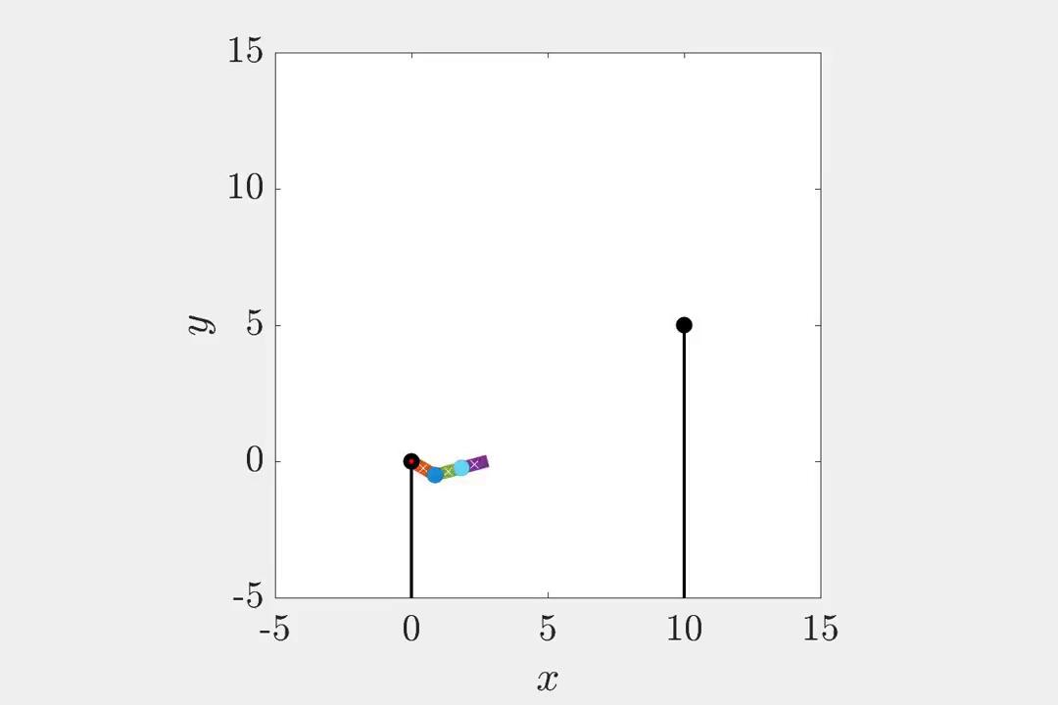
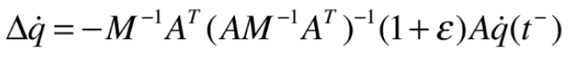
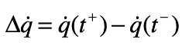
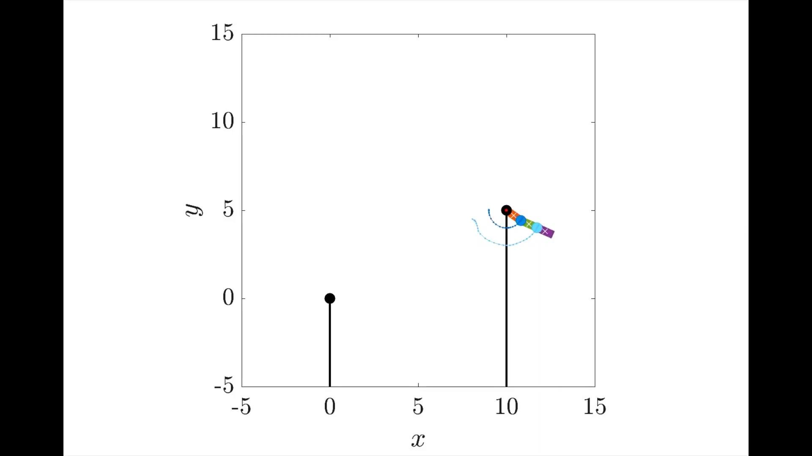
Simulation: Catch another bar
Determine to catch another bar:
(lower_{position} -higher_{position} )² < range
Collision: Solve change in state due to the impulse:
M is mass matrix
A is derived from constraint forces

Slide 18
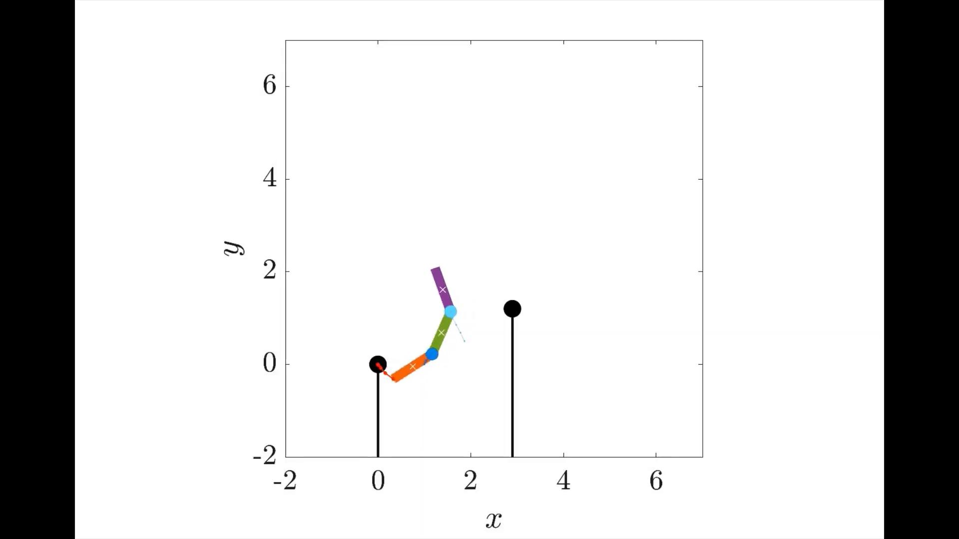
Simulation: select releasing states
Key values when releasing: location(-pi/2~pi/2) and velocity(-1~2) of theta1, theta2, theta3
Statistics： theta1 = pi/2, theta2 = pi/6 and pi/3 are more easier to grab the higher bar
Higher bar location: (2.9,1.2)

Slide 19
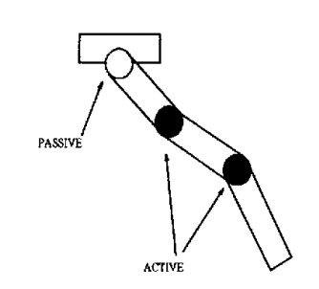
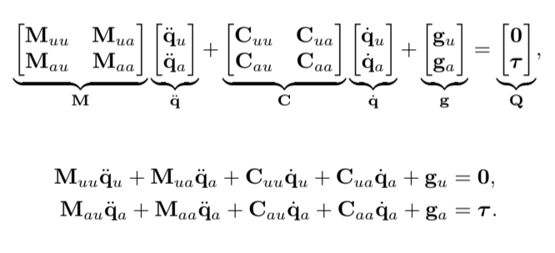
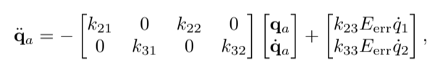
Control Strategy
GIANT

Slide 20
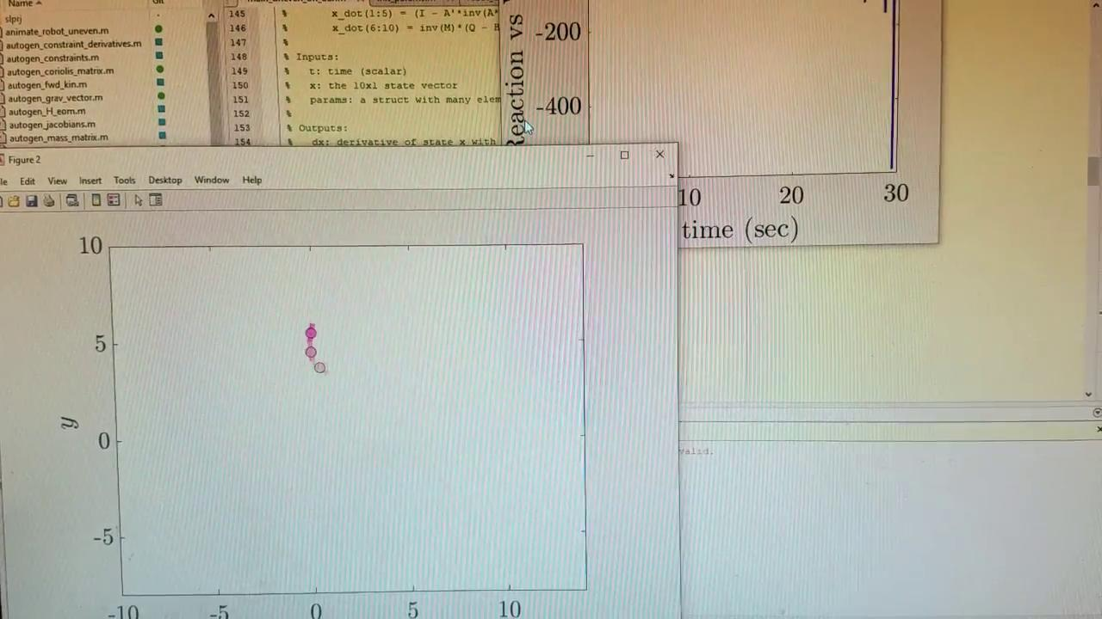
Torque Control

Slide 21
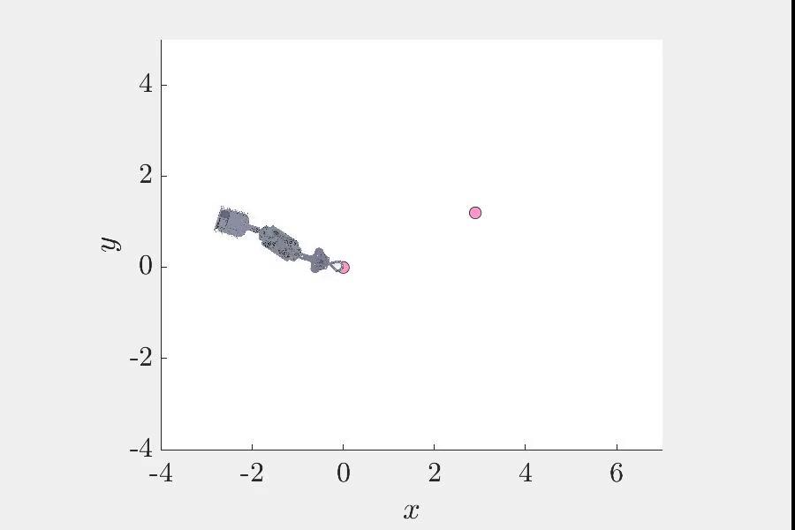
Position Control

Slide 22
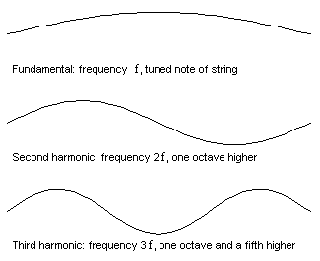
Natural Modes of Vibration

Slide 23
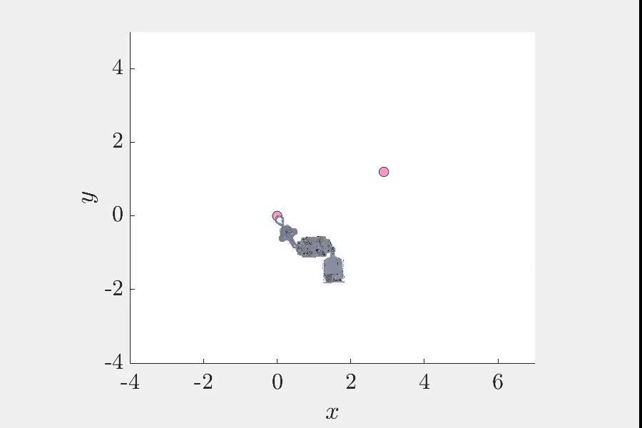
Energy Control

Slide 24
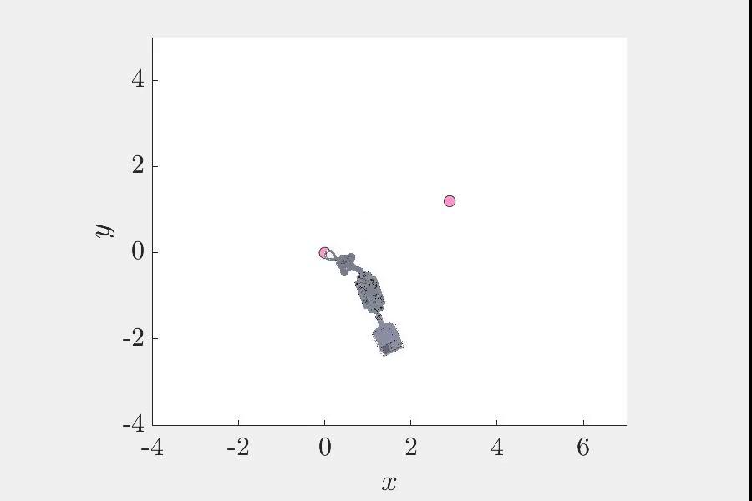
Release and Catch

Slide 25
Things to note:
The contacts between the links were simulated by partially reversing the rotational velocity if the joints angle was greater than 90º (or less than -90º) and increasing in that direction.
Releasing was a two stage process. First, you check if you reached sufficient potential energy (and in the upper left quadrant) then on your next swing up you release at a new potential energy on the right side.
Catching simply checked if the gripper’s X and Y position fit within a bounding box around the second bar. Once it was, it changed X_dot and Y_dot until it was centered at just the right spot.

Slide 26
The Yay’s and the Nay’s..
(+) Produced high fidelity model of our actual robot.
(+) Simulation helped everyone understand the task even better.
(+) Insights into various types of controllers.
(+) Good team effort and task division.
(-) Time management on certain tasks could have been better.
(-) Could not accommodate the motor control tasks as focus had to be given to controller design.

Slide 27
Looking Forward...
In Energy Shaping Controller, we have hardcoded limits for the torque and angles. They are not part of the optimization (not a true constrained optimization).
No control over in-flight moment of inertia.
No focus on gripper control and its dynamics.
More thought needs to be given to second bar detection.
Tkatchev trick has been ignored for now, as it is similar to CHH.
Need to perfect the overhead balancing controller (LQR).

Slide 28
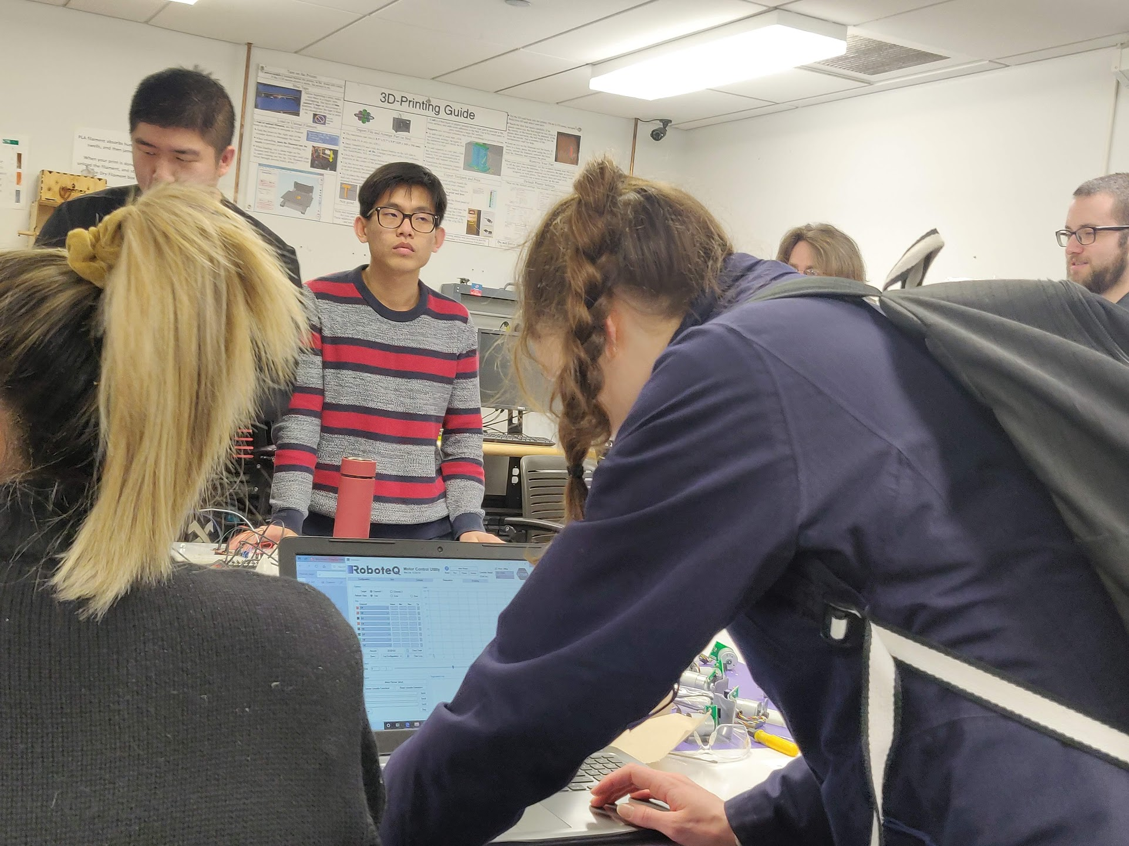
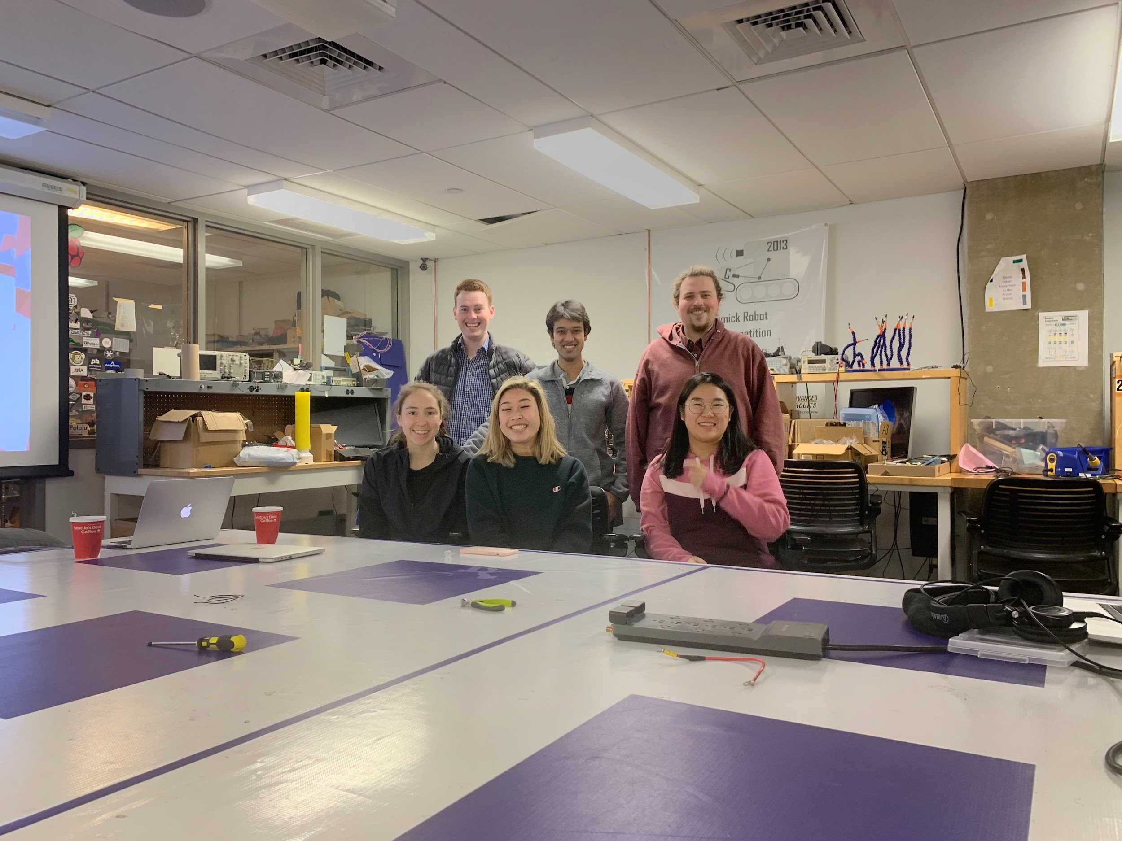
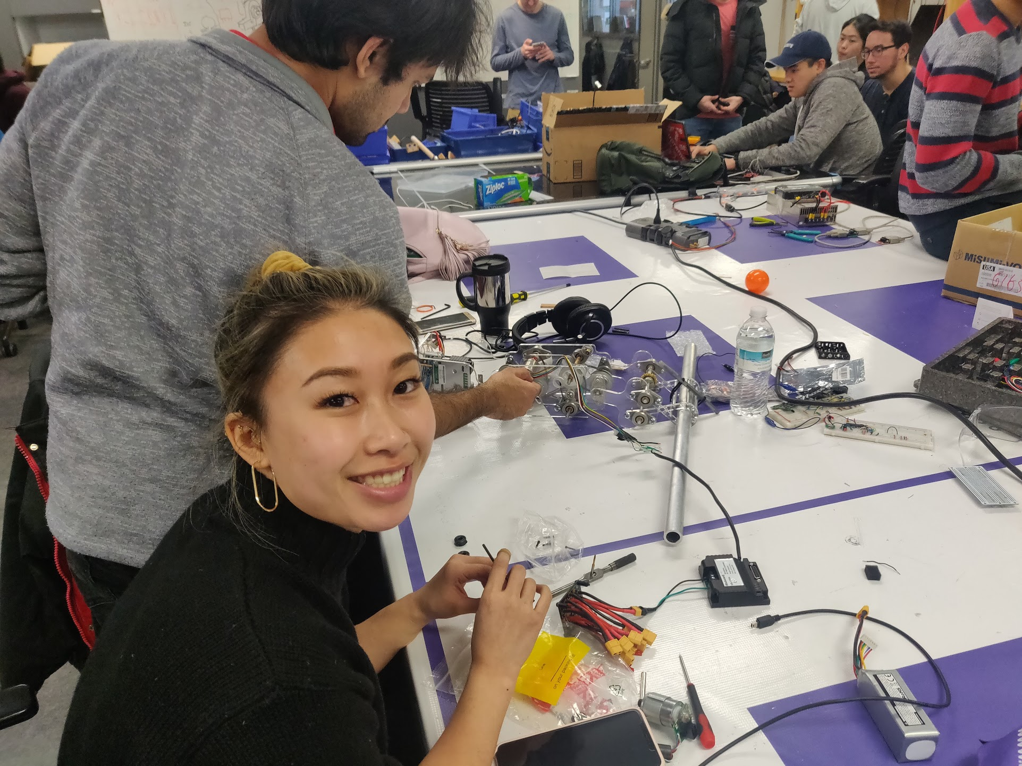
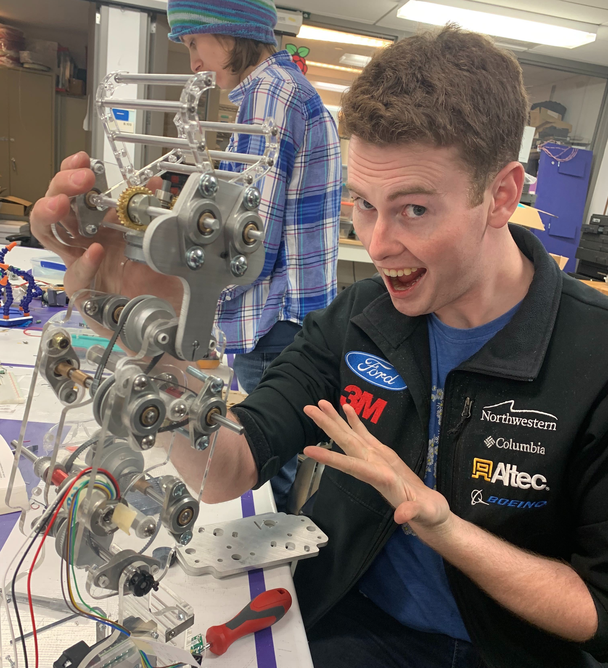
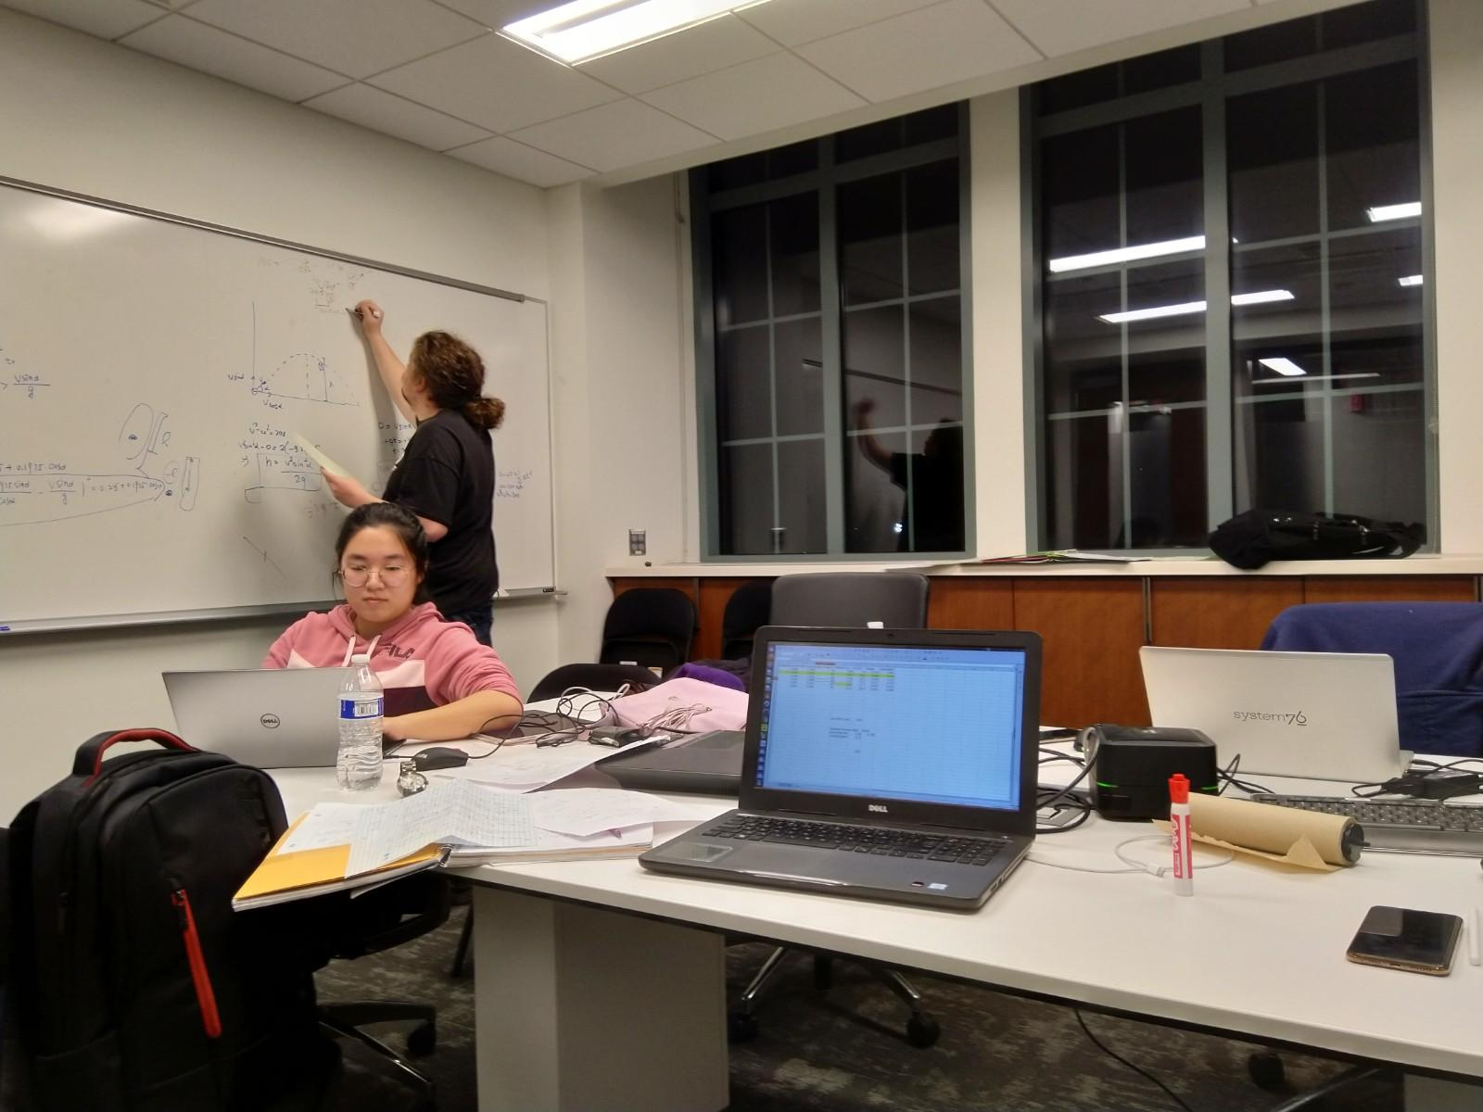
Smiling Through the Pain

Slide 29
Q&A Time

